Slide 1
RiVG Dr. Philipp Wittmann (Administrative Law Judge [VG Karlsruhe] / Judicial Clerk [Bundesverfassungsgericht]) –
Subsidiary Protection
Mass Influx and the Subsidiary Protection of Asylum Seekers
20. / 21. October 2017 - Tübingen
Part I – Mass influx and legal responses in the 90ies
Notes:
1

Slide 2
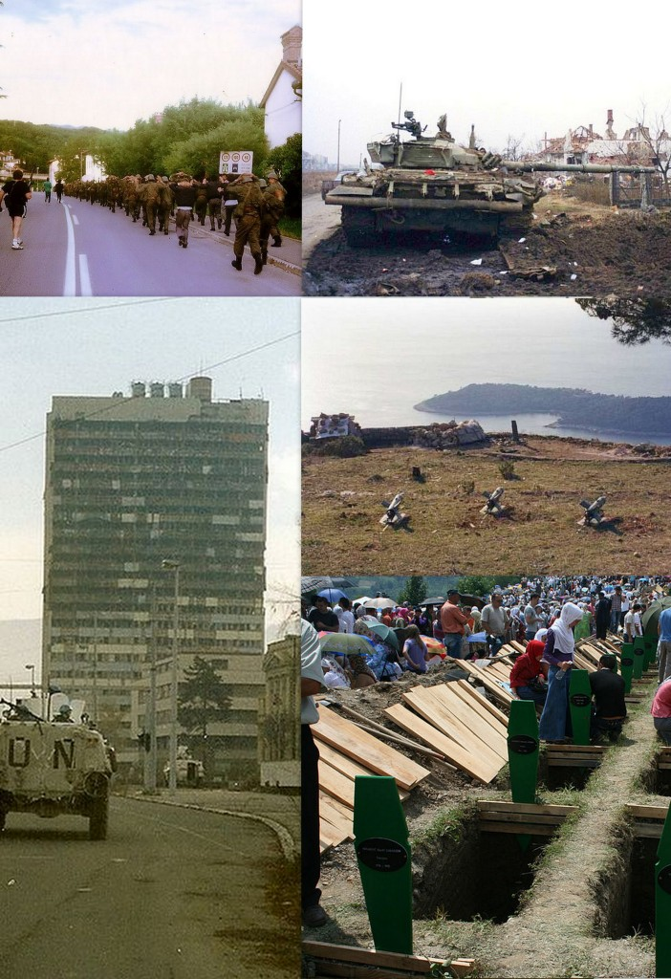
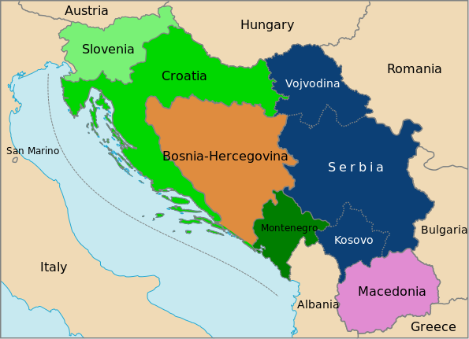
RiVG Dr. Philipp Wittmann (Administrative Law Judge [VG Karlsruhe] / Judicial Clerk [Bundesverfassungsgericht]) –
Subsidiary Protection
Mass influx I: Wars in former Yugoslavia 1991 – 95
Croatian War (1991 – 95): 20.000 dead, 500.000 refugees
Bosnian War (1992 – 1995): 100.000 dead, 2.200.000 refugees
Notes:
2

Slide 3
Notes:
3

Slide 4
forms of protection (before 2006) – prerequisites
 | Asylum (Art. 16a Basic Law) | Refugee Status (1951 refugee convention) | National ban on deportation (§ 60 V / VII AufenthG)
protects from | (targeted) persecution | (targeted) persecution | considerable concrete danger (i.e. “real risk”) to life, limb or liberty (but: protection from dangers to which parts of the population are generally exposed only in extreme cases) OR return to the destination country would constitute a breach of the ECHR (i.e. torture, inhuman treatment)
reasons for persecution | „political“ grounds | race / religion / nationality / political opinion / membership of a particular social group | irrelevant
actors of persecution / harm | state actors statelike actors | state / statelike actors private actors (if no protection by state actors is available) | irrelevant
typical examples | state persecution of religious minorities | persecution of religious minorities | life-threatening diseases without remedy in destination country post traumatic stress disorder (PTSD)
B7VK=j4N?A3
Notes:
4

Slide 5
forms of protection (before 2006) – legal consequences
 | Asylum / refugee status | national deportation ban
temporary residence permit | yes (3 years, extension possible) §§ 25 I, II 1 alt. 1, § 26 I 3 AufenthG | only if no other destination state is available (up to 3 years, extension possible) § 25 III AufenthG, § 26 I 1 AufenthG
privileged access to permanent residence permit (settlement permit) | yes (3 years waiting period) § 26 III AufenthG | only non-privileged access available (5 years waiting period) §§ 9, 26 IV AufenthG
privileged subsequent immigration of dependents (spouses, children etc.) | yes §§ 32 Abs. 2 S. 2, § 36 Abs. 1 AufenthG | no subsequent immigration only in exceptional cases § 29 III 1 AufenthG
B7VK=j4N?A3
Notes:
5

Slide 6
RiVG Dr. Philipp Wittmann (Administrative Law Judge [VG Karlsruhe] / Judicial Clerk [Bundesverfassungsgericht]) –
Subsidiary Protection
Mass Influx and legal responses (I)
Art. 16 Basic Law (until 30. June 1993)
(1) […]
(2) […] Persons persecuted on political grounds shall have the right of asylum.
Art. 16a Basic Law (current)
(1) Persons persecuted on political grounds shall have the right of asylum.
(2) Paragraph (1) of this Article may not be invoked by a person who enters the federal territory from a member state of the European Communities or from another third state in which application of the Convention Relating to the Status of Refugees and of the Convention for the Protection of Human Rights and Fundamental Freedoms is assured. […]
(3) – (5) […]
Notes:
6

Slide 7
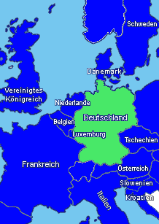
RiVG Dr. Philipp Wittmann (Administrative Law Judge [VG Karlsruhe] / Judicial Clerk [Bundesverfassungsgericht]) –
Subsidiary Protection
Germany – surrounded by „safe third states“ …
Notes:
7

Slide 8
RiVG Dr. Philipp Wittmann (Administrative Law Judge [VG Karlsruhe] / Judicial Clerk [Bundesverfassungsgericht]) –
Subsidiary Protection
Mass Influx and legal responses (II)
Article 6 Dublin Convention (Dublin I, created in 1990, in force since 1997)
[now replaced by Art. 13 Regulation (EU) No. 604/2013 (Dublin III)]
When it can be proved that an applicant for asylum has irregularly crossed the border into a Member State by land, sea or air, having come from a non-member State of the European Communities, the Member State this entered shall be responsible for examining the application for asylum.
Section 29 Asylum Act (AsylG) - Inadmissible applications
(1) An application for asylum shall be inadmissible if
1. another country is responsible for conducting the asylum procedure
a) according to Regulation (EU) No 604/2013 […]
b) based on other European Union law or another international treaty;
2. – 5. […]
Notes:
8

Slide 9
RiVG Dr. Philipp Wittmann (Administrative Law Judge [VG Karlsruhe] / Judicial Clerk [Bundesverfassungsgericht]) –
Subsidiary Protection
Germany – surrounded by „safe third states“ …
…and „Dublin“-states
Notes:
9

Slide 10
Notes:
10

Slide 11
Notes:
11

Slide 12
Mass Influx and the Subsidiary Protection of Asylum Seekers
Part II –
Subsidiary protection status
Notes:
12

Slide 13
forms of protection (before 2006) – prerequisites
 | Asylum (Art. 16a Basic Law) | Refugee Status (1951 refugee convention) | National ban on deportation (§ 60 V / VII AufenthG)
protects from | (targeted) persecution | (targeted) persecution | considerable concrete danger (i.e. “real risk”) to life, limb or liberty (but: protection from dangers to which parts of the population are generally exposed only in extreme cases) OR return to the destination country would constitute a breach of the ECHR (i.e. torture, inhuman treatment)
reasons for persecution | „political“ grounds | race / religion / nationality / political opinion / membership of a particular social group | irrelevant
actors of persecution / harm | state actors statelike actors | state / statelike actors private actors (if no protection by state actors is available) | irrelevant
examples | state persecution of religious minorities | persecution of religious minorities | life-threatening diseases without remedy in destination country post traumatic stress disorder (PTSD)
„safe third state clause“ | yes (since 1993) (prohibits invocation of Art. 16a GG) | yes (since 1997) (Dublin III-procedure; i.e. state of first entry is (usually) responsible) | no (but: deportation to „safe“ state still possible)
B7VK=j4N?A3
Notes:
13

Slide 14
forms of protection (before 2006) – legal consequences
 | Asylum / refugee status | national deportation ban
temporary residence permit | yes (3 years, extension possible) | only if no other destination state is available (up to 3 years, extension possible)
privileged access to permanent residence permit (settlement permit) | yes (3 years waiting period) | only non-privileged access available (5 years waiting period)
privileged subsequent immigration of dependents (spouses, children etc.) | yes | no subsequent immigration only in exceptional cases
B7VK=j4N?A3
Notes:
14

Slide 15
RiVG Dr. Philipp Wittmann (Administrative Law Judge [VG Karlsruhe] / Judicial Clerk [Bundesverfassungsgericht]) –
Subsidiary Protection
Different levels of protection and gaps in protection
Example: From 2012 on, it was agreed that refugees returning to syria faced the danger of being questioned and tortured by the Assad regime and could thus not be returned to Syria.
but: Is this „only“ inhuman treatment (triggering only a deportation ban according to § 60 V AufenthG) or can the treatment of returnees by the syrian government be considered „persecution for reasons of political opinion or membership of a particular social group“ (leading to refugee status)?
note: General dangers of war would not have been sufficient to trigger a national deportation ban according to § 60 VII AufenthG (because it is a danger to which the population is generally exposed and there is usually no extreme risk of death or bodily harm upon return)
Notes:
15

Slide 16
RiVG Dr. Philipp Wittmann (Administrative Law Judge [VG Karlsruhe] / Judicial Clerk [Bundesverfassungsgericht]) –
Subsidiary Protection
Subsidiary protection
Art. 2 lit. f) Council Directive 2004/83/EC
[recast in 2011 as Directive 2011/95/EU]
‘person eligible for subsidiary protection’ means a third country national […] who does not qualify as a refugee but in respect of whom substantial grounds have been shown for believing that the person concerned, if returned to his or her country of origin […] would face a real risk of suffering serious harm […].
Article 15 Council Directive 2004/83/EC
Serious harm consists of:
(a) death penalty or execution; or
(b) torture or inhuman or degrading treatment or punishment […]; or
(c) serious and individual threat to a civilian's life or person by reason of indiscriminate violence in situations of international or internal armed conflict.
Notes:
16

Slide 17
forms of protection – prerequisites
 | Asylum (Art. 16a Basic Law) | Refugee Status (1951 refugee convention) | Subsidiary protection (Dir. 2011/95/EU) | National ban on deportation (§ 60 V / VII AufenthG)
protects from | (targeted) persecution | (targeted) persecution | “serious harm” death penalty torture, inhuman treatment / punishment serious and individual threat to a civilian’s life or person by reason of indiscriminate violence in armed conflict | considerable concrete danger (i.e. “real risk”) to life, limb or liberty (but: protection from dangers to which parts of the population are generally exposed only in extreme cases) OR return to the destination country would constitute a breach of the ECHR (i.e. torture, inhuman treatment)
reasons for persecution | „political“ grounds | race / religion / nationality / political opinion / membership of a particular social group | irrelevant | irrelevant
actors of persecution / harm | state actors statelike actors | state / statelike actors private actors (if no protection by state actors is available) | state / statelike actors private actors (if no protection by state actors is available) | irrelevant
examples | state persecution of religious minorities | persecution of religious minorities | blood vengeance war | life-threatening diseases without remedy in destination country PTSD
„safe third state clause“ | yes (prohibits invocation of Art. 16a GG) | yes (Dublin III-procedure; i.e. state of first entry is (usually) responsible) | yes (Dublin III-procedure; i.e. state of first entry is (usually) responsible) | no (but: deportation to „safe“ state still possible)
B7VK=j4N?A3
Notes:
17

Slide 18
forms of protection – legal consequences
 | Asylum / refugee status | subsidiary protection | national deportation ban
temporary residence permit | yes (3 years, extension possible) §§ 25 I, II 1 alt. 1, § 26 I 3 AufenthG | yes (1 year, extension possible) §§ 25 II 1 alt. 2, § 26 I 4 AufenthG | only if no other destination state is available (up to 3 years, extension possible) § 25 III AufenthG, § 26 I 1 AufenthG
privileged access to permanent residence permit (settlement permit) | yes (3 years waiting period) § 26 III AufenthG | only non-privileged access available (5 years waiting period) §§ 9, 26 IV AufenthG | only non-privileged access available (5 years waiting period) §§ 9, 26 IV AufenthG
privileged subsequent immigration of dependents (spouses, children etc.) | yes (§§ 32 Abs. 2 S. 2, § 36 Abs. 1 AufenthG) | yes (with settlement permit) non-privileged access available (until 2016) | no subsequent immigration only in exceptional cases
B7VK=j4N?A3
Notes:
18

Slide 19
Mass Influx and the Subsidiary Protection of Asylum Seekers
Part III –
Mass influx in 2016, subsidiary protection and legal responses
Notes:
19

Slide 20
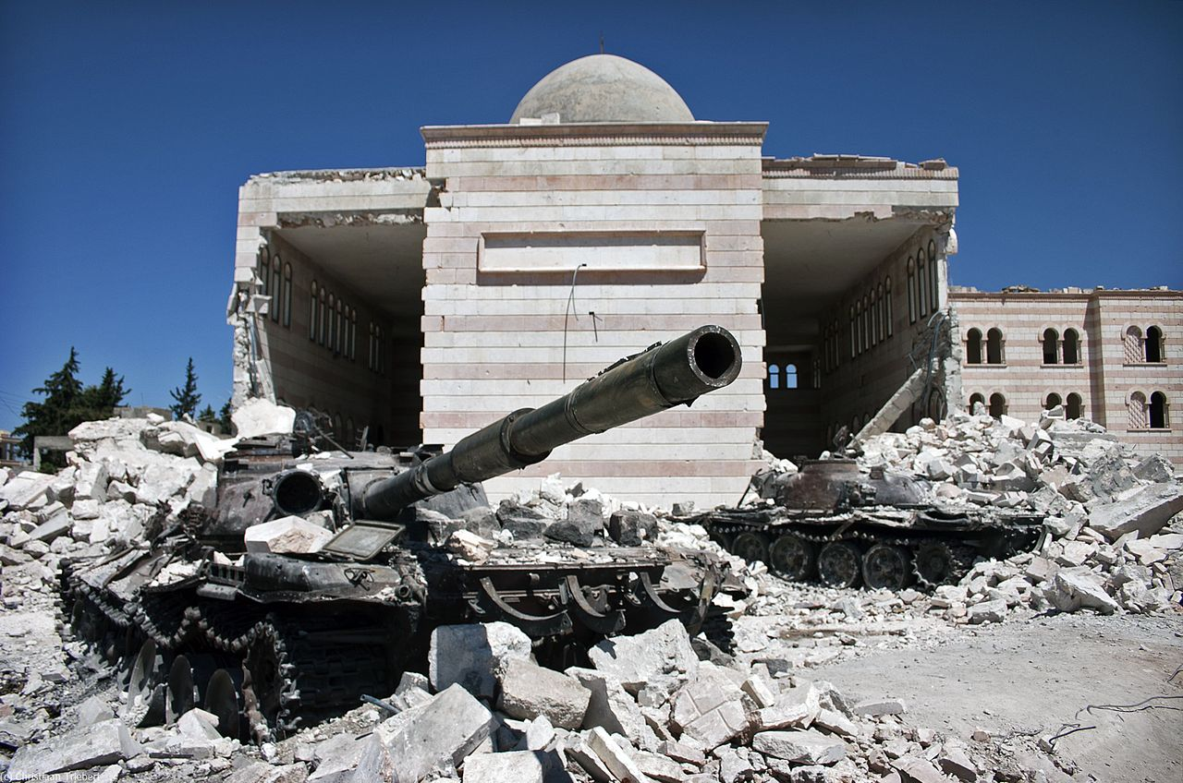
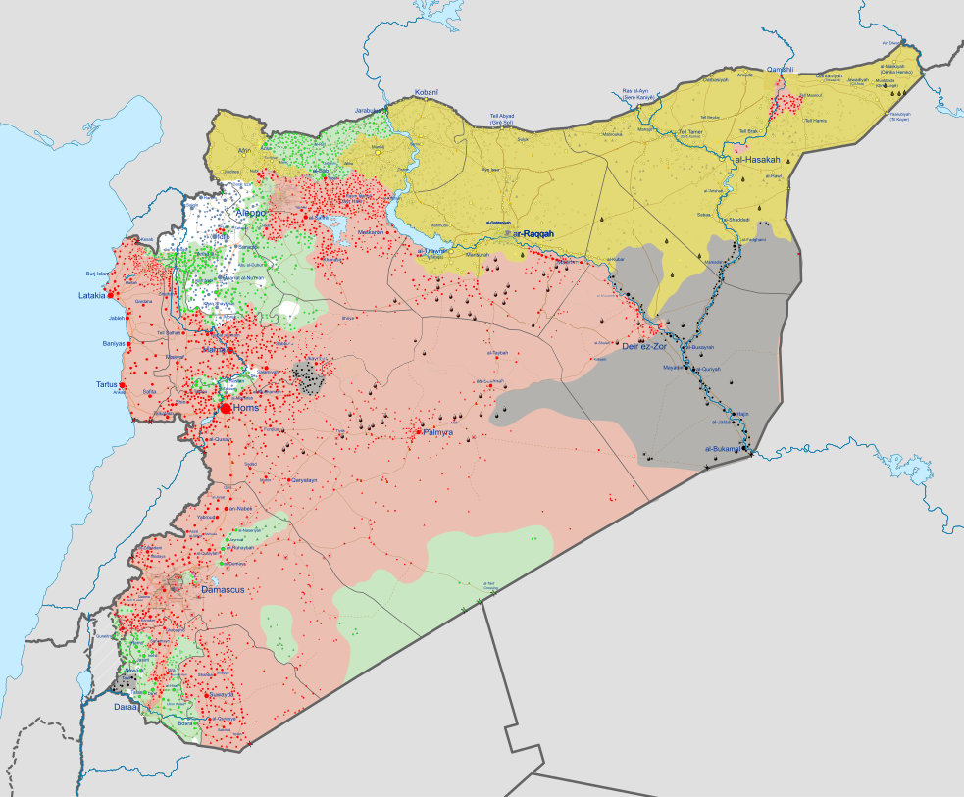
RiVG Dr. Philipp Wittmann (Administrative Law Judge [VG Karlsruhe] / Judicial Clerk [Bundesverfassungsgericht]) –
Subsidiary Protection
Mass influx II: Civil war in Syria (2011 - )
330.000 – 475.000 dead
> 5.100.000 refugees
Notes:
20

Slide 21
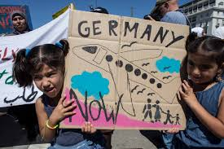
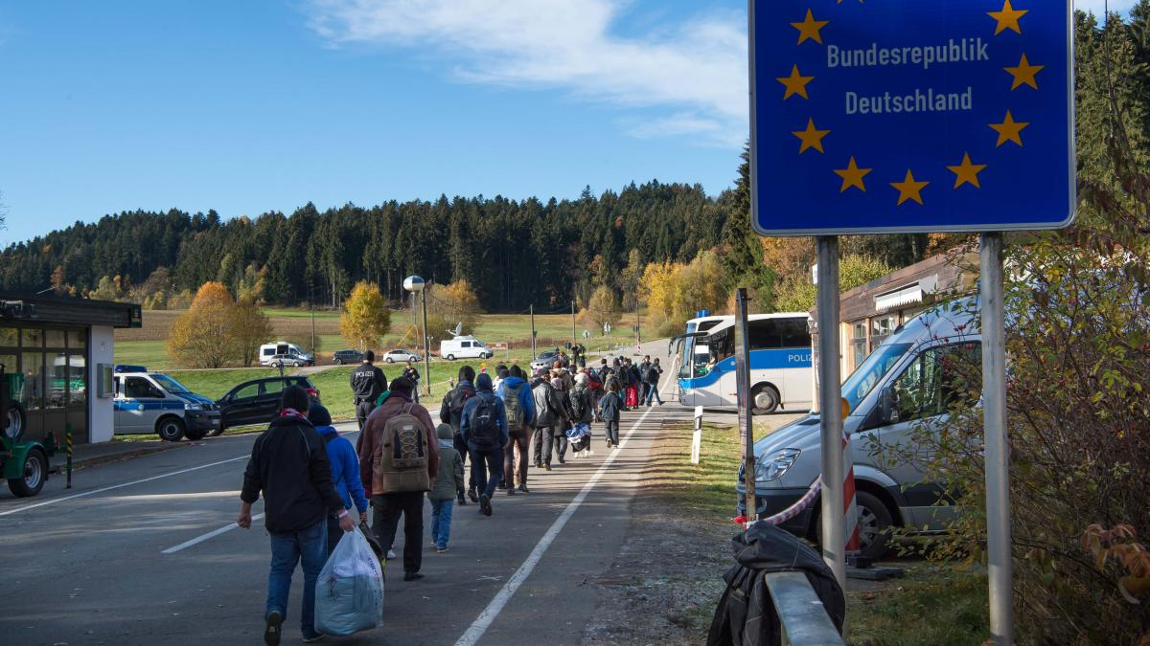
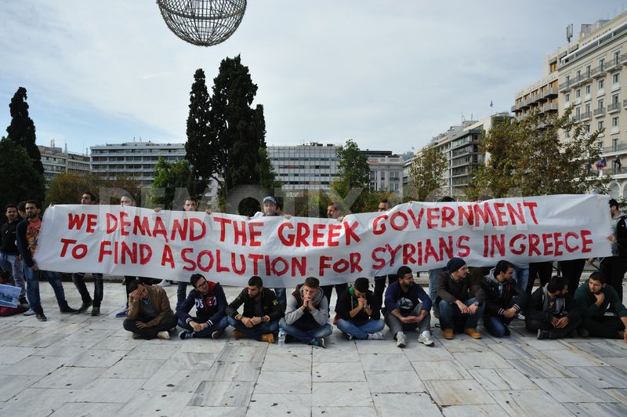
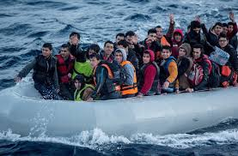
RiVG Dr. Philipp Wittmann (Administrative Law Judge [VG Karlsruhe] / Judicial Clerk [Bundesverfassungsgericht]) –
Subsidiary Protection
Germany – surrounded by safe third states and „Dublin“-states
Notes:
21

Slide 22
Notes:
22

Slide 23
RiVG Dr. Philipp Wittmann (Administrative Law Judge [VG Karlsruhe] / Judicial Clerk [Bundesverfassungsgericht]) –
Subsidiary Protection
 | Decisions of the Federal Office for Migration and Refugees
Year | Total Number | Decisions on the merits |  |  |  |  | Formal Decisions (f.e. Dublin Procedure)
 |  | Refugee Status |  | Subsidiary Protection | Prohibition of Deportation | unfounded | inadmissible
 |  | Art. 16a Basic Law | 1951 Refugee Convention
2008 | 20.817 | 1,1 % | 33,9 % | 0,6 % | 2,1 % | 32,5 % | 29,8 %
2010 | 48.187 | 1,3 % | 14,7 % | 1,1 % | 4,4 % | 56,6 % | 21,0 %
2012 | 61.826 | 1,2 % | 13,0 % | 11,3 % | 2,3 % | 49,7 % | 22,6 %
2014 | 128.911 | 1,8 % | 24 % | 4,0 % | 1,6 % | 33,4 % | 35,2 %
2015 | 282.726 | 0,7 % | 48,5 % | 0,6 % | 0,7 % | 32,4 % | 17,8 %
2016 | 695.733 | 0,3 % | 36,8 % | 22,1 % | 3,5 % | 25,0 % | 12,6 %
Notes:
23

Slide 24
RiVG Dr. Philipp Wittmann (Administrative Law Judge [VG Karlsruhe] / Judicial Clerk [Bundesverfassungsgericht]) –
Subsidiary Protection
In 2016: Temporary (?) suspension of subsequent immigration
§ 104 AufenthG
– (12) […]
(13) Up until 16 March 2018 the subsequent immigration of dependants shall not be granted to persons who were granted a temporary residence permit pursuant to Section 25 (2), sentence 1, second alternative [i.e. subsidiary protection], after 17 March 2016. […] Sections 22, 23 shall remain unaffected.
Notes:
24

Slide 25
forms of protection – legal consequences
 | Asylum / refugee status | subsidiary protection | national deportation ban
temporary residence permit | yes (3 years, extension possible) §§ 25 I, II 1 alt. 1, § 26 I 3 AufenthG | yes (1 year, extension possible) §§ 25 II 1 alt. 2, § 26 I 4 AufenthG | only if no other destination state is available; up to 3 years, extension possible) § 25 III AufenthG, § 26 I 1 AufenthG
privileged access to permanent residence permit (settlement permit) | yes (3 years waiting period) § 26 III AufenthG | only non-privileged access available (5 years waiting period) §§ 9, 26 IV AufenthG | only non-privileged access available (5 years waiting period) §§ 9, 26 IV AufenthG
privileged subsequent immigration of dependents (spouses, children etc.) | yes (§§ 32 Abs. 2 S. 2, § 36 Abs. 1 AufenthG) | yes (with settlement permit) non-privileged access available but: subsequent immigration (privileged or otherwise) currently suspended until (at least) 16.3.2018 (§ 104 XIII AufenthG) | no subsequent immigration only in exceptional cases
B7VK=j4N?A3
Notes:
25

Slide 26
RiVG Dr. Philipp Wittmann (Administrative Law Judge [VG Karlsruhe] / Judicial Clerk [Bundesverfassungsgericht]) –
Subsidiary Protection
 | Decisions of the Federal Office for Migration and Refugees
Year | Total Number | Decisions on the merits |  |  |  |  | Formal Decisions (f.e. Dublin Procedure)
 |  | Refugee Status |  | Subsidiary Protection | Prohibition of Deportation | unfounded | inadmissible
 |  | Art. 16a Basic Law | 1951 Refugee Convention
2008 | 20.817 | 1,1 % | 33,9 % | 0,6 % | 2,1 % | 32,5 % | 29,8 %
2010 | 48.187 | 1,3 % | 14,7 % | 1,1 % | 4,4 % | 56,6 % | 21,0 %
2012 | 61.826 | 1,2 % | 13,0 % | 11,3 % | 2,3 % | 49,7 % | 22,6 %
2014 | 128.911 | 1,8 % | 24 % | 4,0 % | 1,6 % | 33,4 % | 35,2 %
2015 | 282.726 | 0,7 % | 48,5 % | 0,6 % | 0,7 % | 32,4 % | 17,8 %
2016 | 695.733 | 0,3 % | 36,8 % | 22,1 % | 3,5 % | 25,0 % | 12,6 %
Notes:
26

Slide 27
RiVG Dr. Philipp Wittmann (Administrative Law Judge [VG Karlsruhe] / Judicial Clerk [Bundesverfassungsgericht]) –
Subsidiary Protection
Current political and legal issues
Are refugees from Syria entitled to subsidiary protection (“inhuman treatment”) or to refugee status (“persecution for reasons of political opinion“)?
see Higher Administrative Court Mannheim, 9.8.2017 – A 11 S 710/17 – (subsidiary protection for 63 year old male)
see Higher Administrative Court Mannheim, 14.6.2017 – A 11 S 511/17 – (refugee status for 24 year old male who evaded compulsory military service)
Is the suspension of subsequent migration to be prolonged?
Christian Social Party (CSU): make permanent
Christian Democratic Party (CDU): prolong
Liberals (FDP): selective prolongation
Green Party, Social Democratic Party (SPD), Left Party („Die Linke“) : do not prolong
Is the suspension of subsequent migration compatible with the right to familiy life (Art. 6 Basic Law; Art. 8 ECHR)?
see Federal Constitutional Court (BVerfG), 11.10.2017 – q BvR 1758/17 – (complaint not manifestly unfounded, but no temporary injunction)
Notes:
27

